Slide 1
Hazard

Slide 2
Hazard
تاخيرها ممکن است باعث پالس هاي ناخواسته شوند
Glitch
هازارد:
مداري که احتمال ايجاد glitch در آن هست، هازارد دارد.
دو نوع:
استاتيک
ديناميک

Slide 3
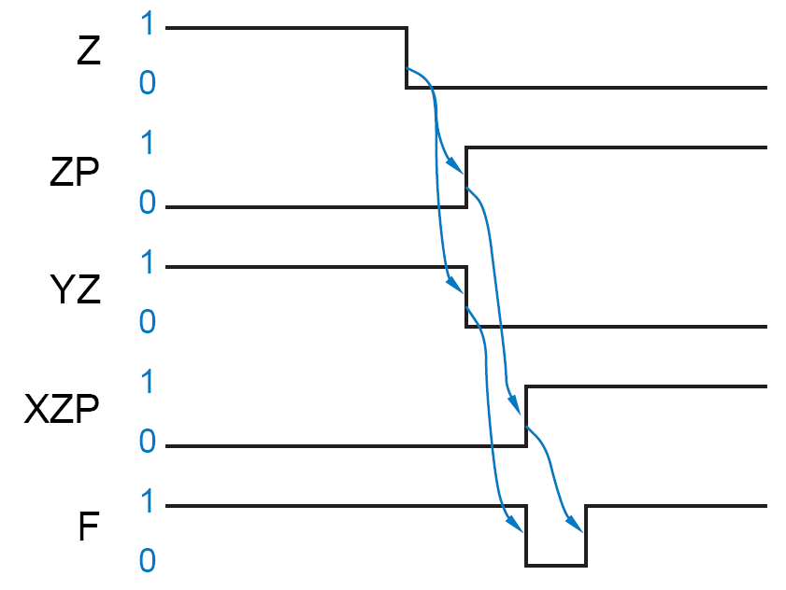
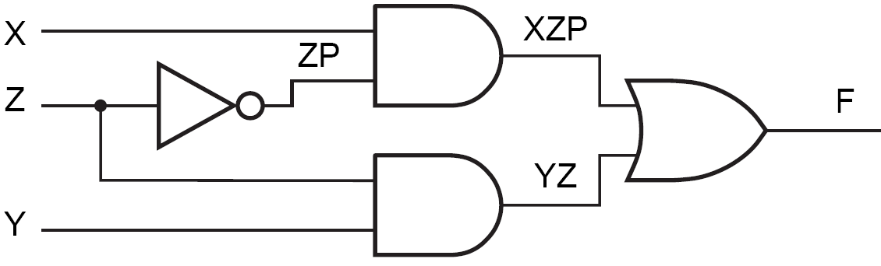
مثال
Initially:
X=Y=Z=1

Slide 4
Static Hazard
Definition:
A static-1 hazard is the possibility of a 0 glitch when we expect the output to remain at a nice steady 1 based on a static analysis
Formal Definition:
A static-1 hazard is a pair of input combinations that:
(a) differ in only one input variable and
(b) both give a 1 output;
such that it is possible for a momentary 0 output to occur during a transition in the differing input variable.

Slide 5

Example
Even though “static” analysis predicts that the output is 1 for both input combinations
X,Y,Z = 111 and X,Y,Z = 110,
F goes to 0 for one unit time.

Slide 6
Static-0 Hazard
A static-0 hazard is just the dual of a static-1 hazard
→ An OR-AND circuit that is the dual of the example circuit would have a static-0 hazard.
A properly designed two-level sum-of-products (AND-OR) circuit has no static-0 hazards.

Slide 7
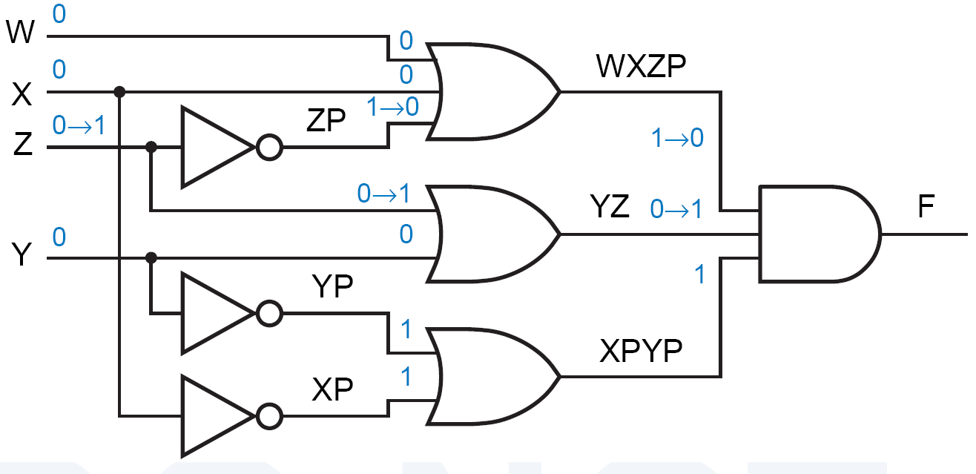
Example
Analyze this:

Slide 8
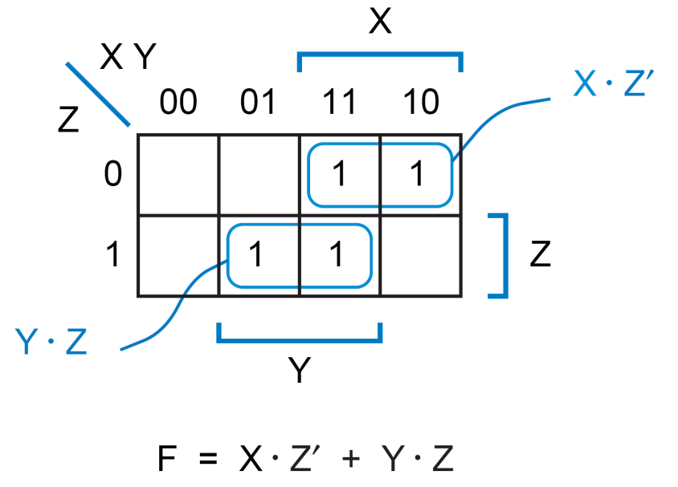
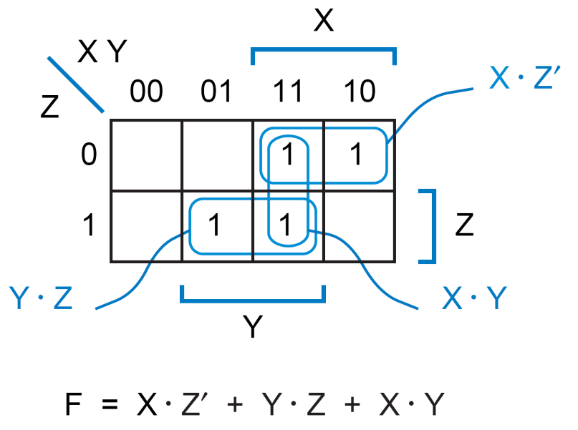
Detecting Hazard
A Karnaugh map can be used to detect static hazards in a two-level SOP or POS circuit.

Slide 9
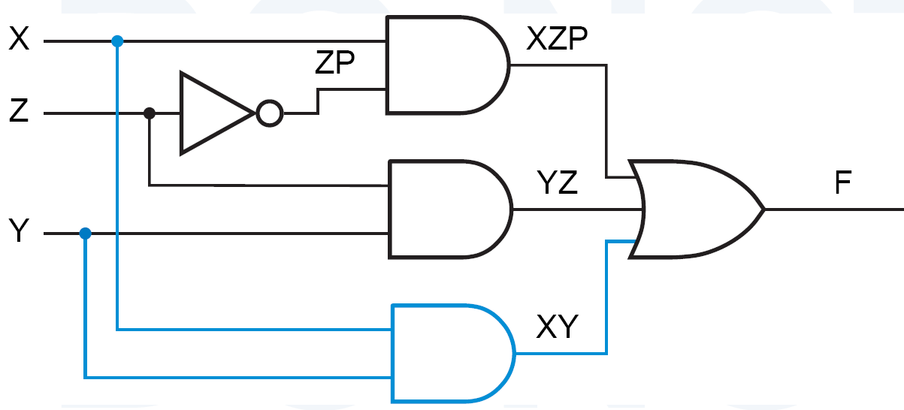

Removing Hazard

Slide 10
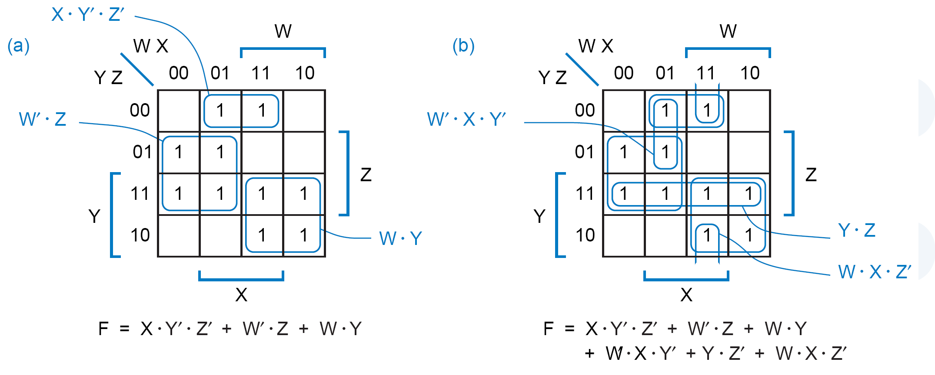
Example

Slide 11
Example

Slide 12
Dynamic Hazard
Dynamic hazard:
The possibility of an output changing more than once as the result of a single input transition.
Multiple output transitions can occur if there are multiple paths with different delays from the changing input to the changing output.

Slide 13
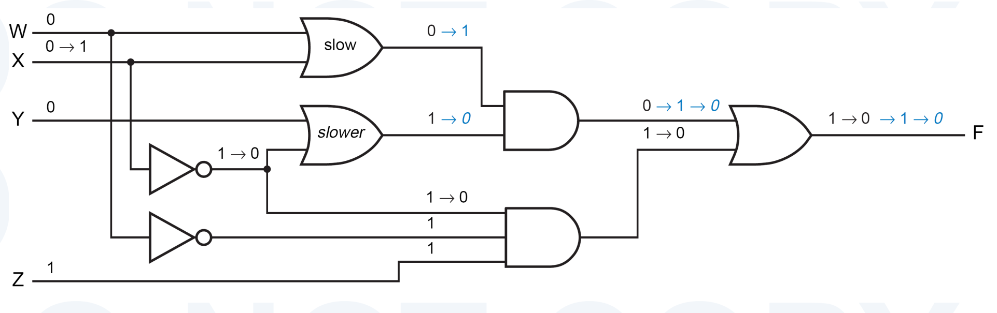
مثال
سه مسير از X به F
W,X,Y,Z = 0,0,0,1 ← F=1
فرض: X يک شود.
فرض: بقية گيت ها سريعند.
اول تغييرات مشکي ← F=0
بعد آبي غير ايتاليک
بعد آبي ايتاليک

Slide 14
Hazard-Free Design
Techniques for finding hazards in arbitrary circuits, are rather difficult to use.
→ When you require a hazard-free design, it’s best to use a circuit structure that is easy to analyze.
In particular, two-level AND-OR circuit has no static-0 or dynamic hazards.
Static-1 hazards may exist in such a circuit but they can be found and eliminated using K-map.

Slide 15
Important Point
Most Hazards are not hazardous:
A well-designed, synchronous digital system is structured so that hazard analysis is not needed for most of its circuits.
In a synchronous system, all of the inputs to a combinational circuit are changed at a particular time, and the outputs are not “looked at” until they have had time to settle to a steady-state value.
Exception: anynch. Reset/preset
Hazard analysis and elimination are typically needed only in the design of asynchronous sequential circuits
Asynchronous circuits are not the mainstream but if you want to design them, an understanding of hazards will be absolutely essential for a reliable result.

Slide 16
Pulse-Shaping Circuit
A
B
C
D
F
A' •A = 0
3 gate delays
D remains high for
three gate delays after
A changes from low to high
F is not always 0!

